Slide 1
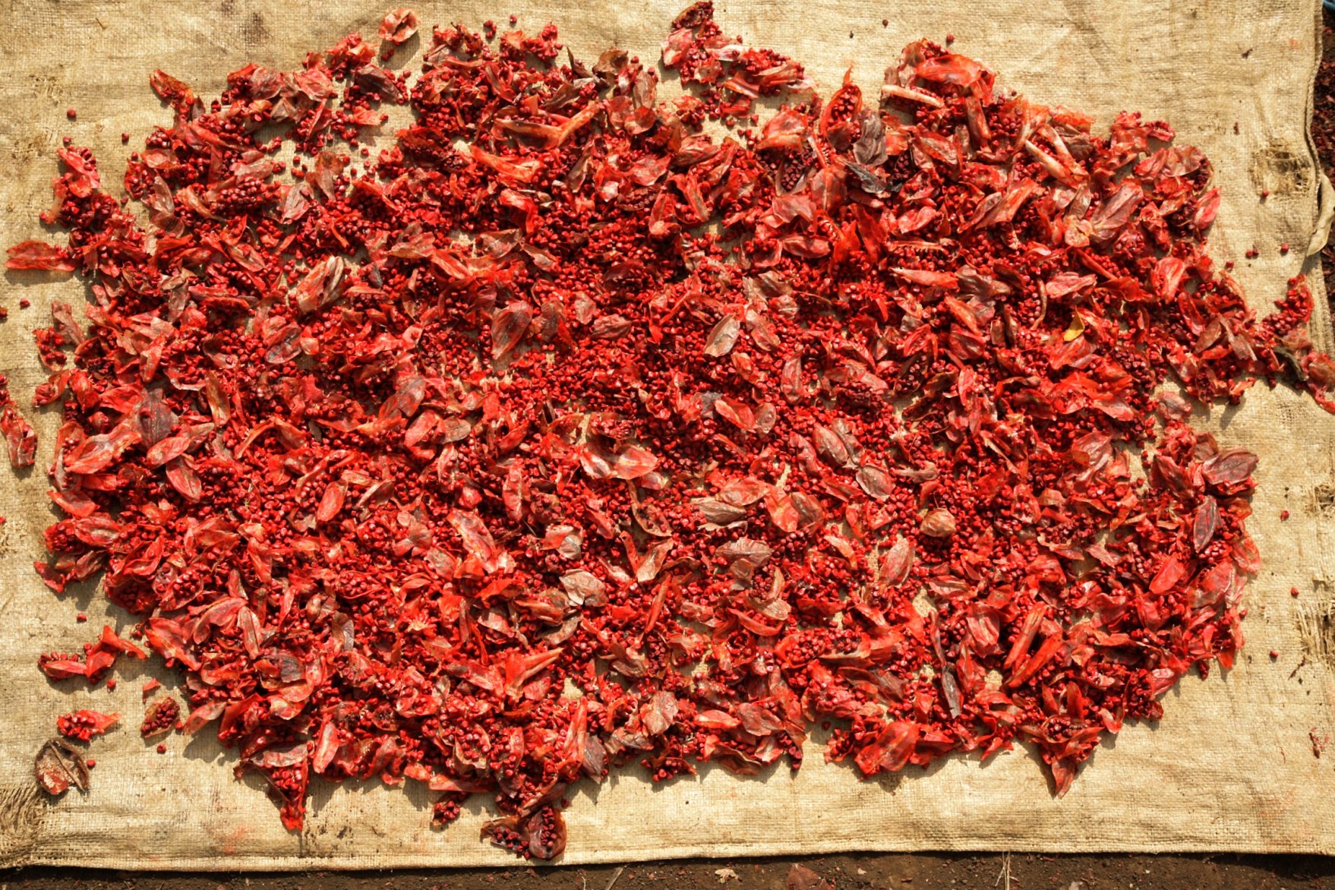
Achiote , Bixa orellana
Folder: Achiote, Ethnobotany; Achiote_Chisec_2006
www.Maya-ethnobotany.org
© FLAAR Mesoamerica 2011

Slide 2
No cost or obligation to use FLAAR PowerPoint presentations (if copyright notice and logo remain in place)
PowerPoint presentations are courtesy of FLAAR Reports for colleges, universities, museums, nature parks, or any comparable educational and scientific institution.
There is no cost or obligation to use these PowerPoint presentations from FLAAR Reports as long as the format, logo, and reference to www.maya-ethnobotany.org remain in place.
However these photographs are all copyright and are not intended for inappropriate use. Inappropriate use is dumping them on your own web site and pretending they are your photos. The ethical way to do this is to leave them on the FLAAR web site(s) and link to them
If there are other pre-Columbian Mesoamerican flowers,plants or trees that you really wish to have a PPT on from FLAAR, please let us know. Also, if you wish Dr Hellmuth to give this lecture himself, at your university, museum, club, or group, anywhere in the world, he lectures around the world every year, especially relative to Maya iconography of plants and animals, and on digital photography of flora and fauna.
If you find this innovative concept of a non-profit research institute providing no-cost PowerPoint presentations to curators, faculty, and students as a good idea, please let us know.
If you find any error or omission in this presentation, or if you know anything that we missed, please let us know to consider it. Write to FrontDesk@FLAAR.org
We have deliberately left the PPT with no text so the speaker who borrows this can add their own words.
www.Maya-ethnobotany.org
© FLAAR Mesoamerica 2011

Slide 3
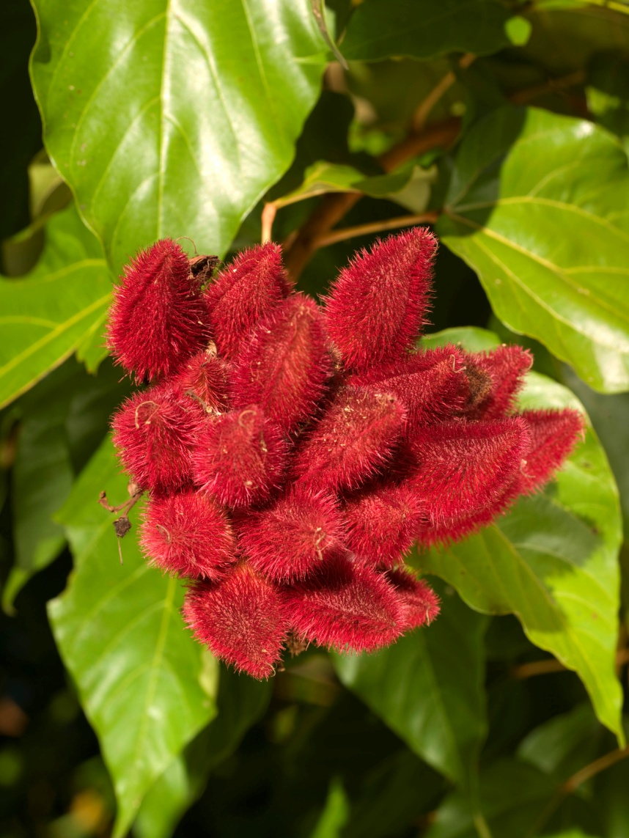
Achiote: plant for Spice and Color
Achiote inmature fruit
Folder: Achiote, Ethnobotany; Achiote_Sayaxche_01
Achiote mature fruit
Folder: Achiote, Ethnobotany; Achiote_Portal_hotel_69
www.Maya-ethnobotany.org
© FLAAR Mesoamerica 2011

Slide 4
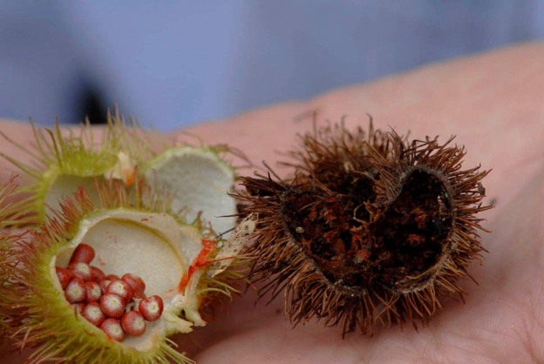
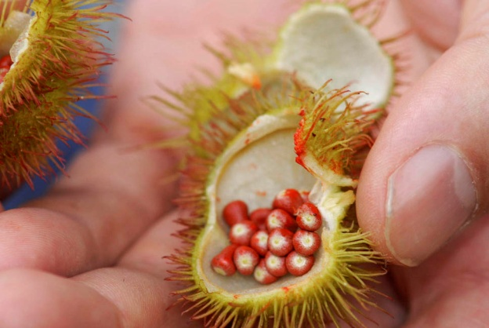
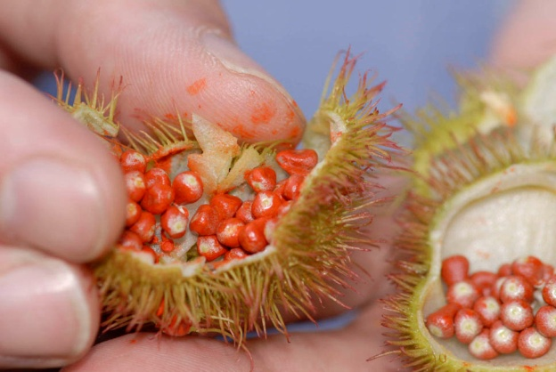
Achiote: plant for Spice and Color
Achiote fruit
Folder: Achiote, Ethnobotany; Achiote_Sayaxche_04
Folder: Achiote, Ethnobotany; Achiote_Sayaxche_05, 04,02 respectively.
www.Maya-ethnobotany.org
© FLAAR Mesoamerica 2011

Slide 5
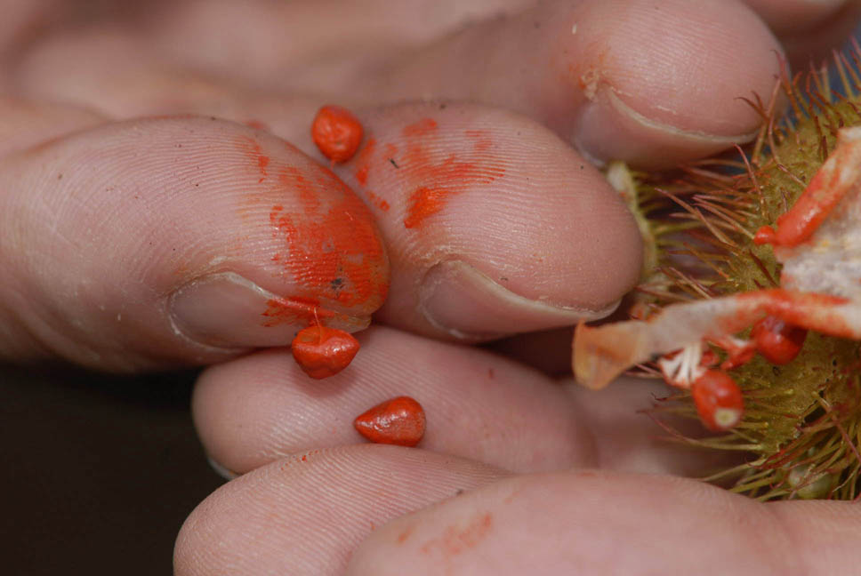
Achiote: plant for Spice and Color
Red color comes from the seeds
Folder: Achiote, Ethnobonaty Achiote_Paso_Caribe4032
Folder: Achiote, Ethnobonaty ; Achiote_Sayaxche_06
www.Maya-ethnobotany.org
© FLAAR Mesoamerica 2011

Slide 6
Achiote: plant for Spice and Color
Achiote Tree
Family Bixacea
Scientific name: Bixa orellana
Folder: Achiote, Ethnobonaty ; Achiote_Porta_hotel_71
www.Maya-ethnobotany.org
© FLAAR Mesoamerica 2011

Slide 7
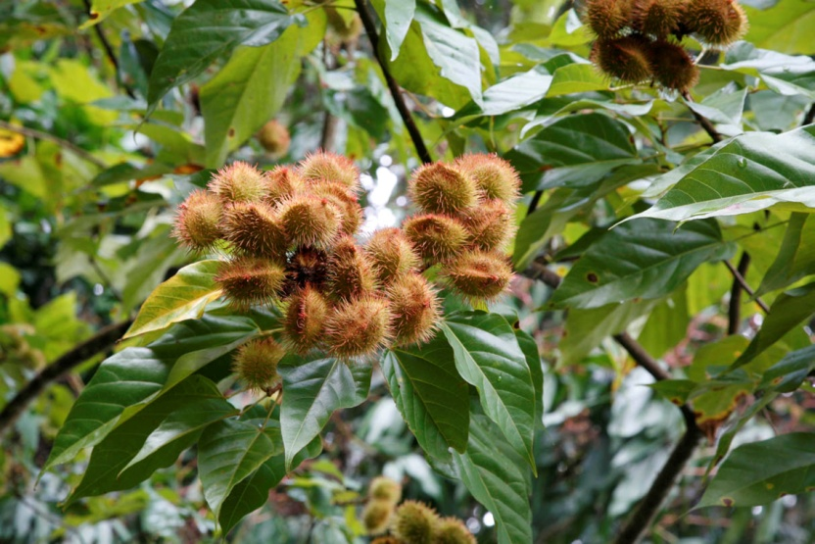
Achiote: plant for Spice and Color
Branches of achiote bush
Photos were taken at Peten, near Sayaxche
Folder: Achiote, Ethnobotany; Achiote_mg_4035
Folder: Achiote, Ethnobotany; Achiote_mg_4034
www.Maya-ethnobotany.org
© FLAAR Mesoamerica 2011

Slide 8
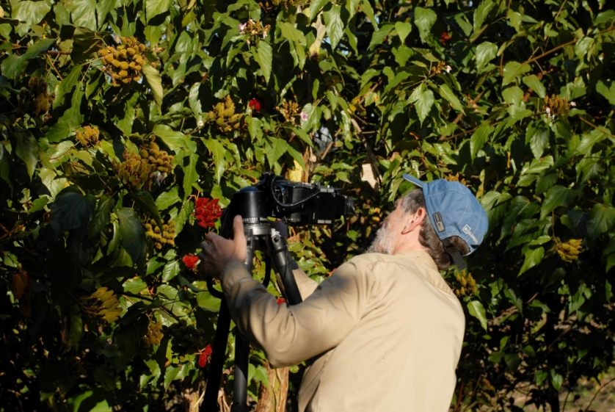
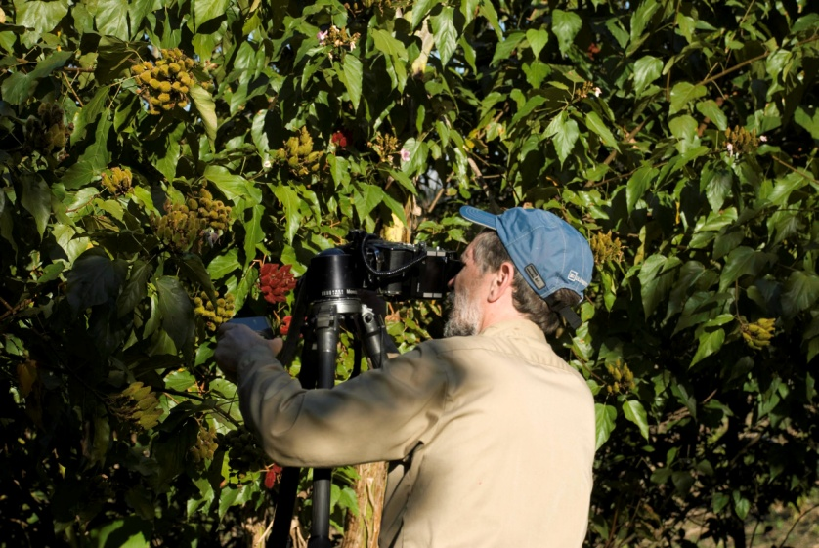
Achiote: plant for Spice and Color
Nicholas Hellmuth taking pictures of achiote
Folder: Achiote, Ethnobonaty ; NH_PhaseOne_achiote_213
Folder: Achiote, Ethnobonaty; NH_PhaseOne_achiote_214
www.Maya-ethnobotany.org
© FLAAR Mesoamerica 2011

Slide 9
Achiote: plant for Spice and Color
Folder: Achiote, Ethnobonaty; NH_PhaseOne_achiote_218
www.Maya-ethnobotany.org
© FLAAR Mesoamerica 2011

Slide 10
Achiote: plant for Spice and Color
For more information visit
www.Maya-ethnobotany.org
All photos were taken by FLAAR Mesoamerica staff. To quote the presentation and the pictures:
Photos (FLAAR, 2011)
FLAAR Mesoamerican. 2011. PowerPoint Presentation about Achiote.
www.Maya-ethnobotany.org
© FLAAR Mesoamerica 2011

Slide 11
www.Maya Ethnobotany.org
Other PowerPoint presentations with photos of other Maya ethnobotany plants from the FLAAR Photo Archive include:
Ceiba tree (Ceiba pentandra)
Papaya (Carica papaya)
Palo de pito (Erythrina berteroana)
© FLAAR Mesoamerica 2011

