Slide 1
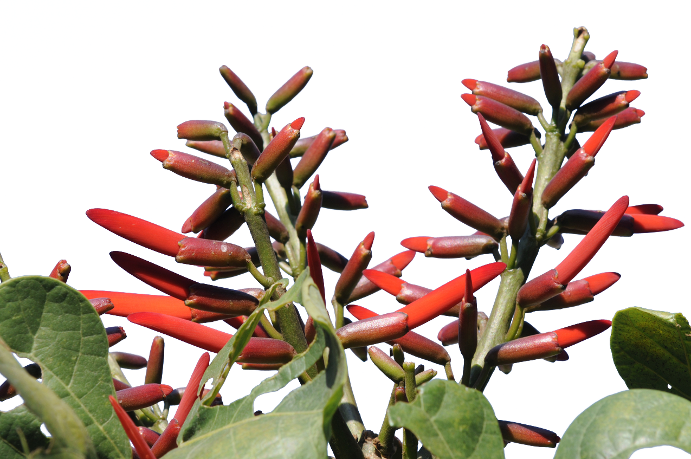
Palo de Pito, Erythrina berteroana
www.Maya-ethnobotany.org
© FLAAR Mesoamerica 2011

Slide 2
No cost or obligation to use FLAAR PowerPoint presentations (if copyright notice and logo remain in place)
PowerPoint presentations are courtesy of FLAAR Reports for colleges, universities, museums, nature parks, or any comparable educational and scientific institution.
There is no cost or obligation to use these PowerPoint presentations from FLAAR Reports as long as the format, logo, and reference to www.maya-ethnobotany.org remain in place.
However these photographs are all copyright and are not intended for inappropriate use. Inappropriate use is dumping them on your own web site and pretending they are your photos. The ethical way to do this is to leave them on the FLAAR web site(s) and link to them
If there are other pre-Columbian Mesoamerican flowers,plants or trees that you really wish to have a PPT on from FLAAR, please let us know. Also, if you wish Dr Hellmuth to give this lecture himself, at your university, museum, club, or group, anywhere in the world, he lectures around the world every year, especially relative to Maya iconography of plants and animals, and on digital photography of flora and fauna.
If you find this innovative concept of a non-profit research institute providing no-cost PowerPoint presentations to curators, faculty, and students as a good idea, please let us know.
If you find any error or omission in this presentation, or if you know anything that we missed, please let us know to consider it. Write to FrontDesk@FLAAR.org
We have deliberately left the PPT with no text so the speaker who borrows this can add their own words.
www.Maya-ethnobotany.org
1
© FLAAR Mesoamerica 2011

Slide 3
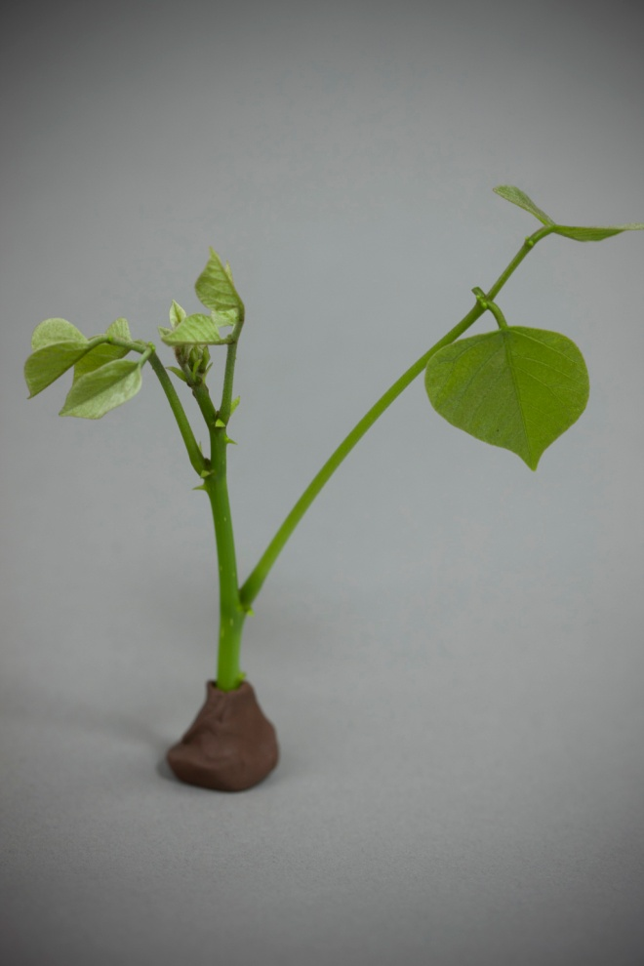
Palo de Pito a plant of Ceremonial use
Palo de pito shoots
Folder:Process, Palo de Pito, Ethnobotany; palo-de-pito-retoño_006
Folder:Process, Palo de Pito, Ethnobotany; palo-de-pito-retoño_004
www.Maya-ethnobotany.org
2
© FLAAR Mesoamerica 2011

Slide 4
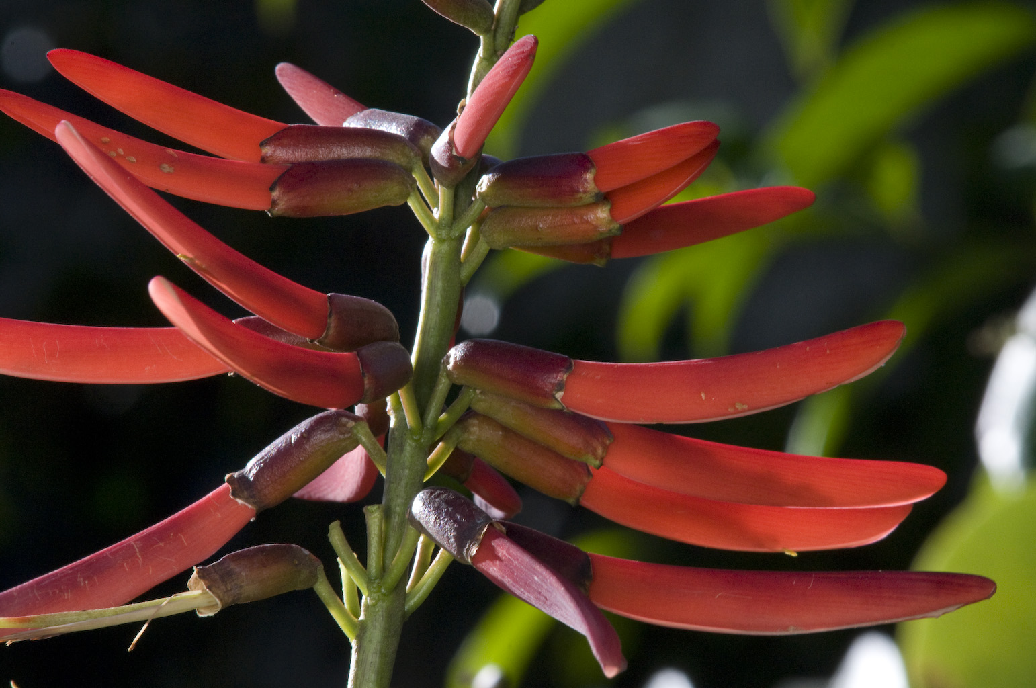
Palo de Pito a plant of Ceremonial use
Palo de pito flower
www.Maya-ethnobotany.org
3
© FLAAR Mesoamerica 2011
Folder: Process, Palodepito, Ethnobotany:Palo_Pito_1_de_Febrero_Nikon_D300_Jaime_015
Notes:
No poner process

Slide 5
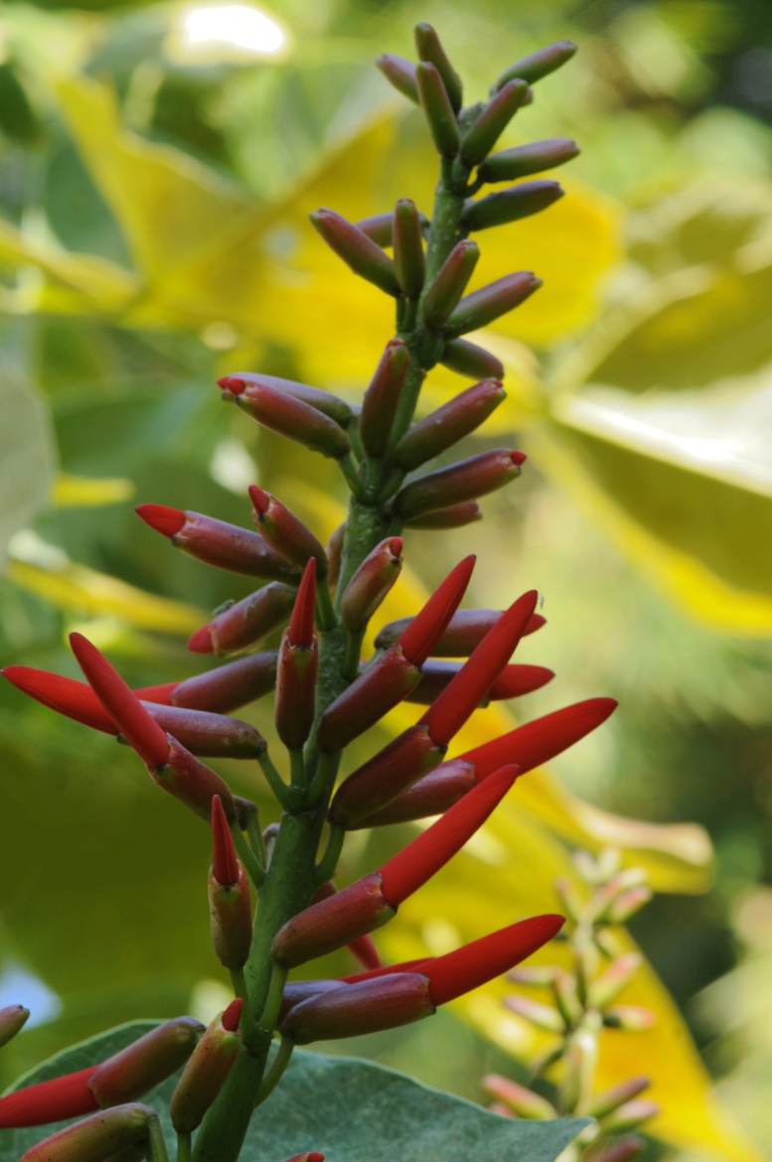
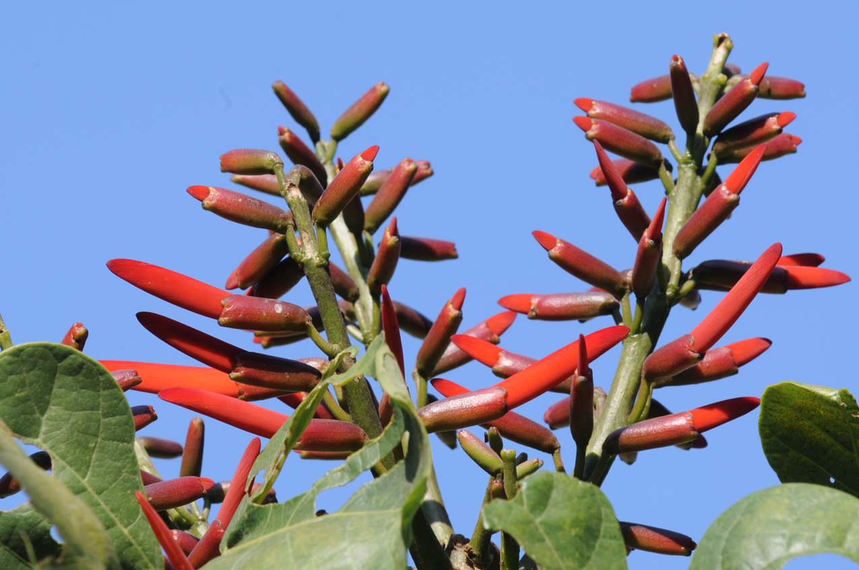
Palo de Pito a plant of Ceremonial use
Family: Fabaceae
Scientific name: Erythrina berteroana
Spanish common name: Palo de pito
Principal Mayan Use: The seeds are usef in ceremonies
Folder: Ethnobotany; Process: Palo_de_Pito_05
Folder: Ethnobotany;: Palo_de_Pito_09
www.Maya-ethnobotany.org
4
© FLAAR Mesoamerica 2011

Slide 6
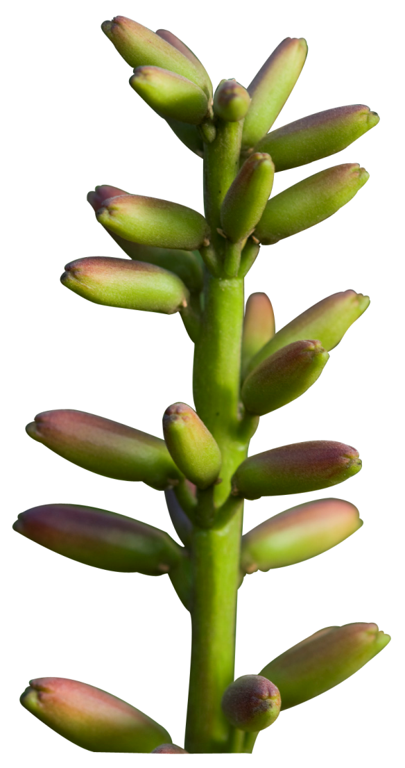
Palo de Pito a plant of Ceremonial use
Distribution: From Mexico to Peru.
In Guatemala you can find it in the edge of forests and as a living fence. Its natural habitat is mostly in the dry forest, though it can be cultivated in the tropical forest also.
In English its name is coral bean, because of the red or bright orange color of the seed.
Folder: Ethnobotany; Palo_Pito_1_de_Febrero_Nikon_D300_Jaime_037_Recortada
www.Maya-ethnobotany.org
5
© FLAAR Mesoamerica 2011

Slide 7
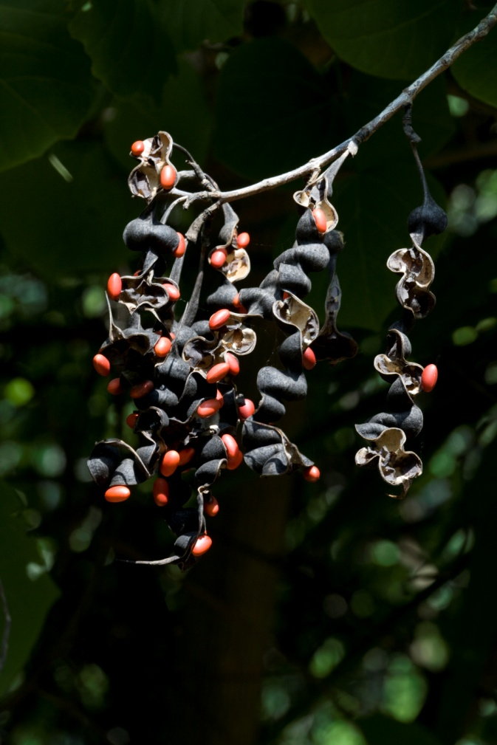
Palo de Pito a plant of Ceremonial use
Folder: Ethnobotany; palo_de_pito_seeds_pods_164
Folder: Ethnobotany; palo_de_pito_seeds_pods_177
www.Maya-ethnobotany.org
6
© FLAAR Mesoamerica 2011

Slide 8
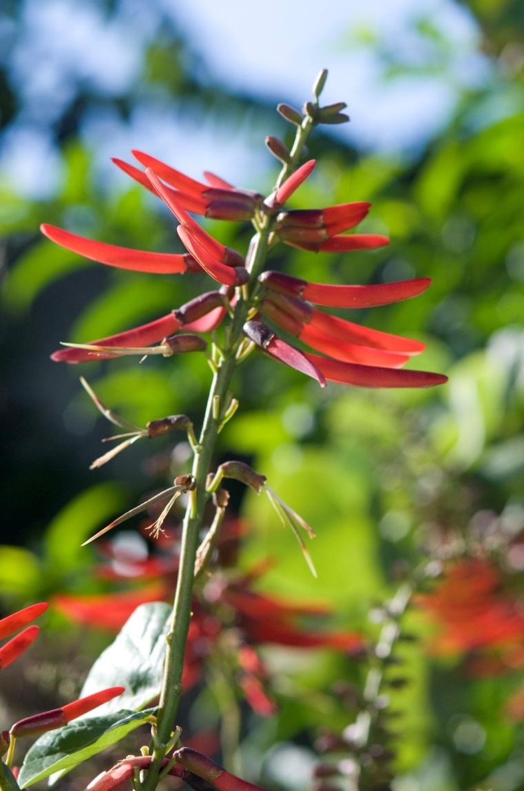
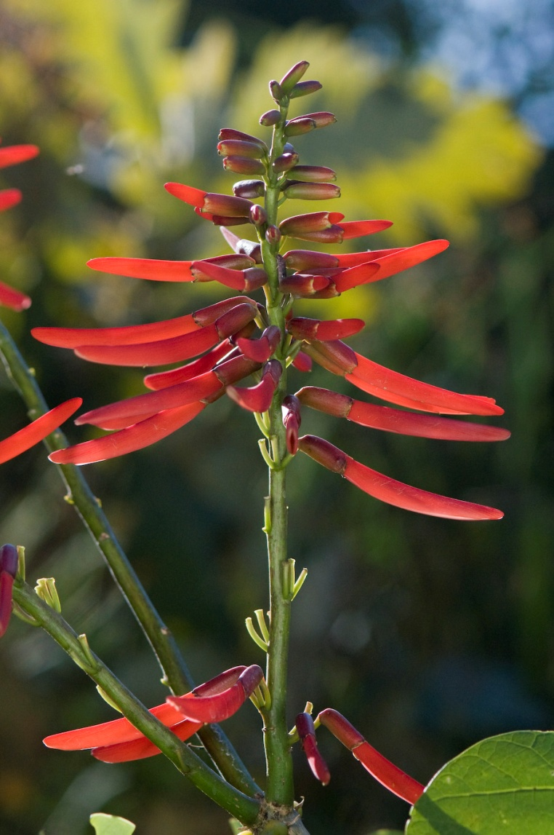
Palo de Pito a plant of Ceremonial use
Folder:: Ethnobotany: Palo_Pito_1_de_Febrero_Nikon_D300_Jaime_004
Folder: Ethnobotany: Palo_Pito_1_de_Febrero_Nikon_D300_Jaime_008
www.Maya-ethnobotany.org
7
© FLAAR Mesoamerica 2011

Slide 9
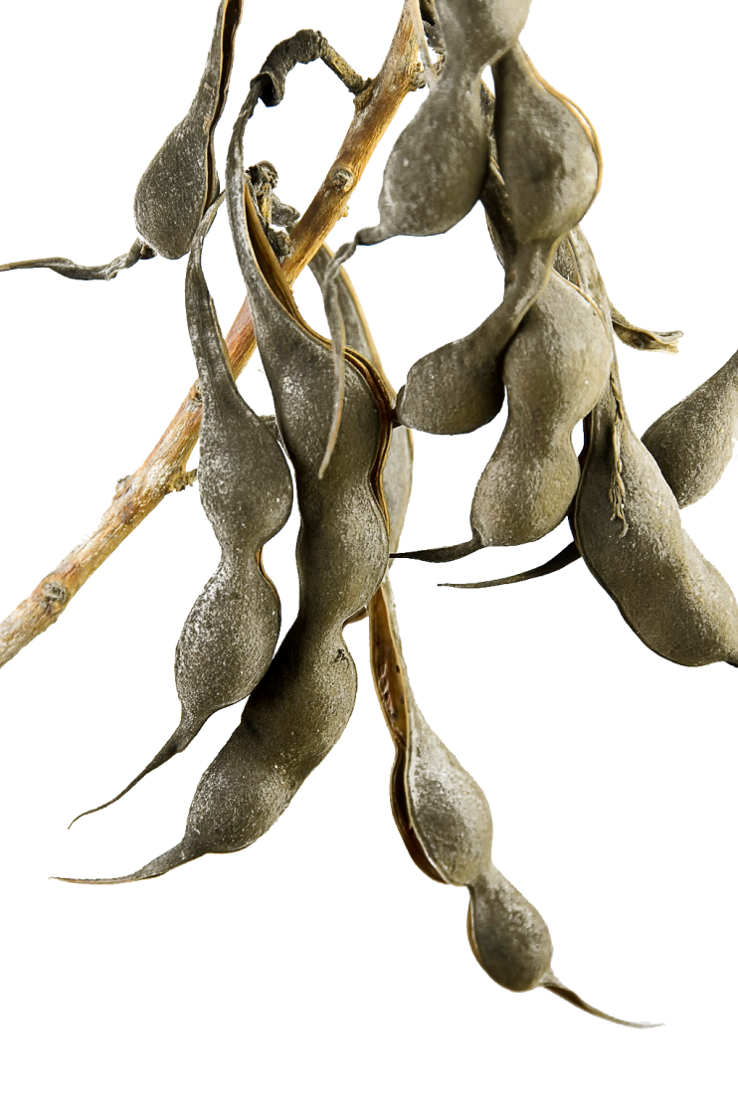
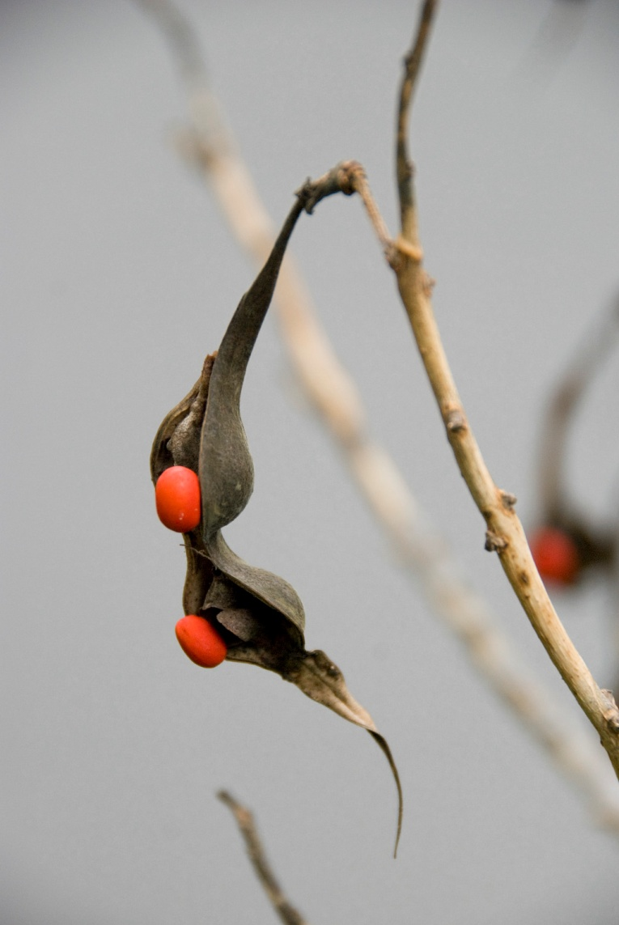
Palo de Pito a plant of Ceremonial use
Palo de pito seed pod
Folder:Ethnobotany; Semillas_Palo_de_Pito_46
Folder:Ethnobotany; Semillas_Palo_de_Pito_46
www.Maya-ethnobotany.org
8
© FLAAR Mesoamerica 2011

Slide 10
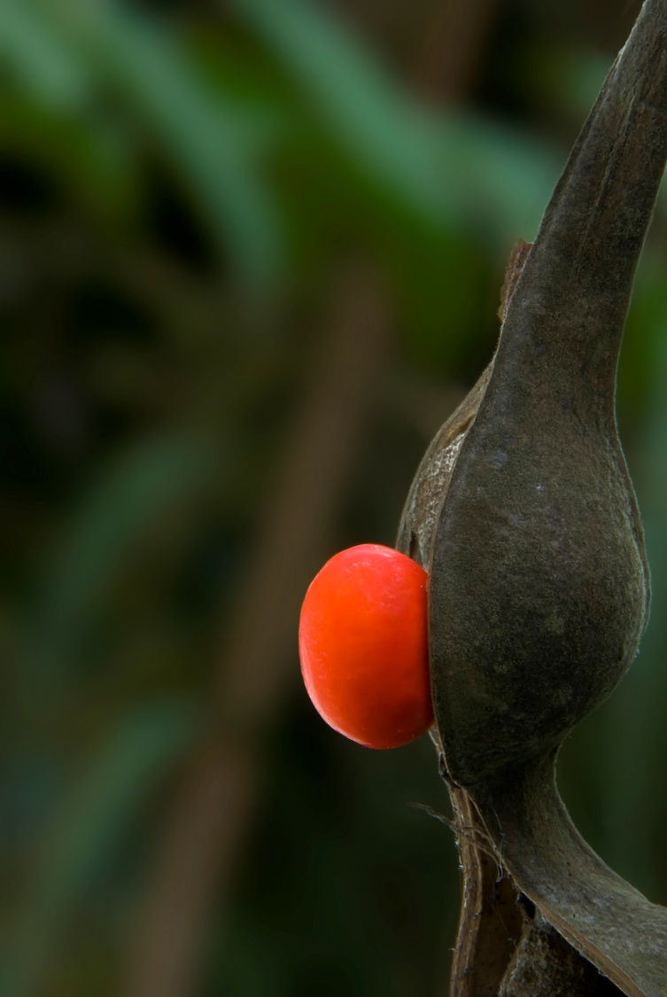
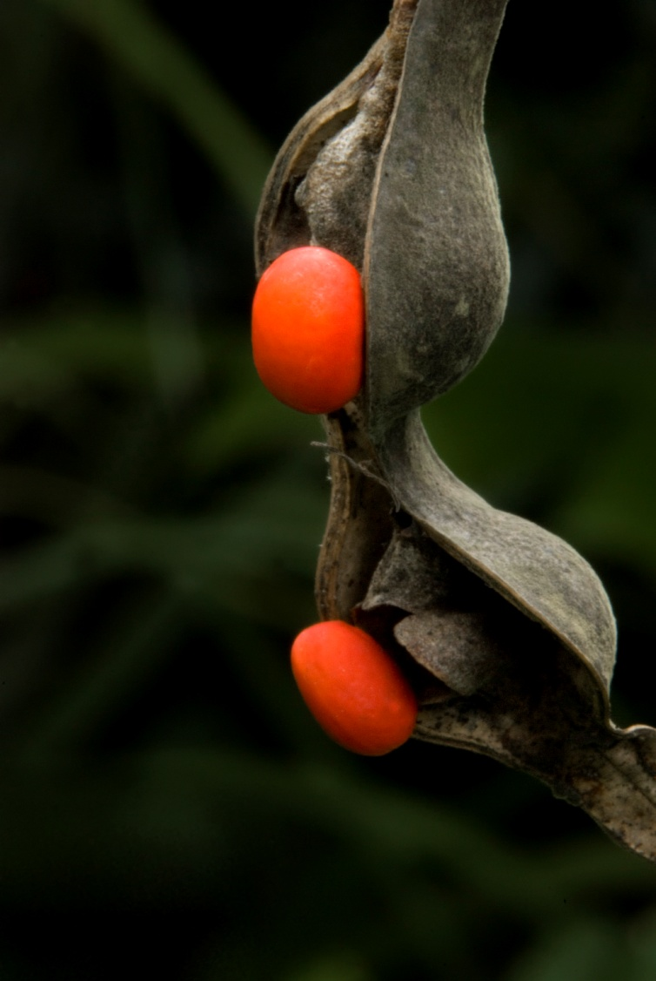
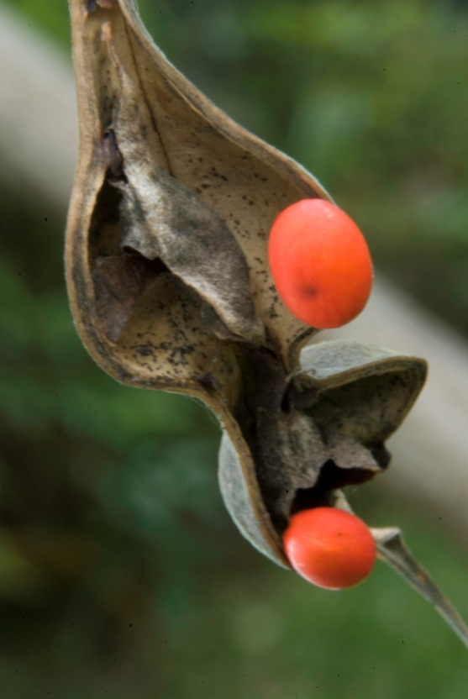
Palo de Pito a plant of Ceremonial use
Palo de pito seed pod
Folder: Ethnobotany: Palo_de_Pito_Semillas_DSC_0580
Folder: Ethnobotany:Palo_de_Pito_Semillas_DSC_0571
Folder: Ethnobotany:Palo_de_Pito_SemillasDSC_0581
www.Maya-ethnobotany.org
9
© FLAAR Mesoamerica 2011

Slide 11
www.Maya Ethnobotany.org
For more information visit
www.Maya-ethnobotany.org
All photos were taken by FLAAR Mesoamerica staff. To quote the presentation and the pictures:
Photos (FLAAR, 2011)
FLAAR Mesoamerican. 2011. PowerPoint Presentation about Palo de Pito. www.maya-ethnobotany.org
www.Maya-ethnobotany.org
10
© FLAAR Mesoamerica 2011

Slide 12
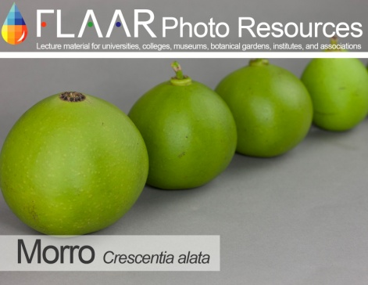
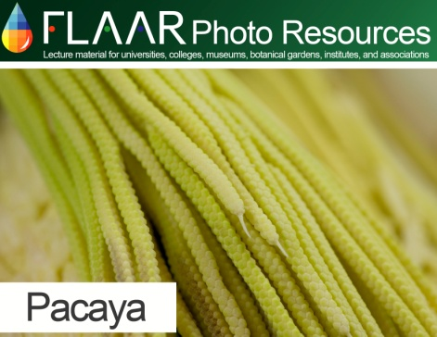
www.Maya Ethnobotany.org
Other PowerPoint presentations with photos of other Maya ethnobotany plants from the FLAAR Photo Archive include:
Morro (Crescentia alata)
Pacaya (Chamaedorea tepejilote)
www.Maya-ethnobotany.org
11

