Slide 1
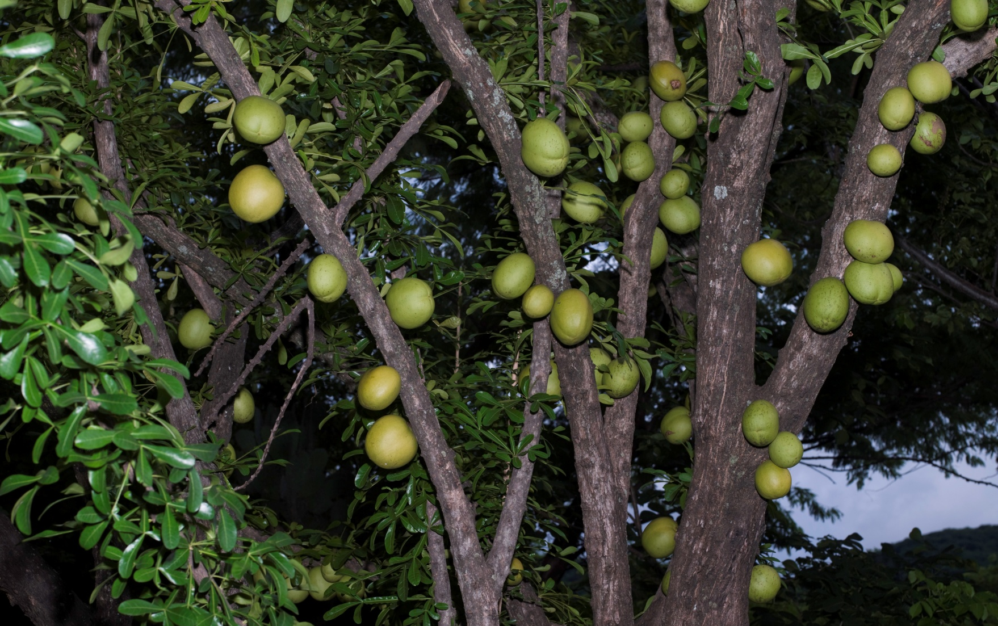
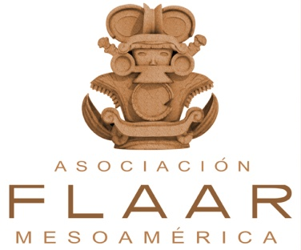
Morro Tree Crescentia alata
Folder: FLAAR-Photos; Ethnobotany; morro_Crescentia_alata_many_650
Maya Ethnobotany.
www.Maya-ethnobotany.org

Slide 2
No cost or obligation to use FLAAR PowerPoint presentations (if copyright notice and logo remain in place)
PowerPoint presentations are courtesy of FLAAR Reports for colleges, universities, museums, nature parks, or any comparable educational and scientific institution.
There is no cost or obligation to use these PowerPoint presentations from FLAAR Reports as long as the format, logo, and reference to www.maya-ethnobotany.org remain in place.
However these photographs are all copyright and are not intended for inappropriate use. Inappropriate use is dumping them on your own web site and pretending they are your photos. The ethical way to do this is to leave them on the FLAAR web site(s) and link to them
If there are other pre-Columbian Mesoamerican flowers,plants or trees that you really wish to have a PPT on from FLAAR, please let us know. Also, if you wish Dr Hellmuth to give this lecture himself, at your university, museum, club, or group, anywhere in the world, he lectures around the world every year, especially relative to Maya iconography of plants and animals, and on digital photography of flora and fauna.
If you find this innovative concept of a non-profit research institute providing no-cost PowerPoint presentations to curators, faculty, and students as a good idea, please let us know.
If you find any error or omission in this presentation, or if you know anything that we missed, please let us know to consider it. Write to FrontDesk@FLAAR.org
We have deliberately left the PPT with no text so the speaker who borrows this can add their own words.
www.Maya-ethnobotany.org
1
© FLAAR Mesoamerica 2011

Slide 3
A sacred plant, Morro Tree (Crescentia alata)
Folder: Ethnobotany; morro_Crescentia_alata_tree_644
www.Maya-ethnobotany.org
2
© FLAAR Mesoamerica 2011

Slide 4
A sacred plant, Morro Tree (Crescentia alata)
Family: Bignoniaceae
Sientific name: Crescentia alata
Common name: Morro
Distribution: From Mexico to Colombia, Peru and Brazil.
Folder: Ethnobotany; morro_Crescentia_alata_many_660
www.Maya-ethnobotany.org
3
© FLAAR Mesoamerica 2011

Slide 5
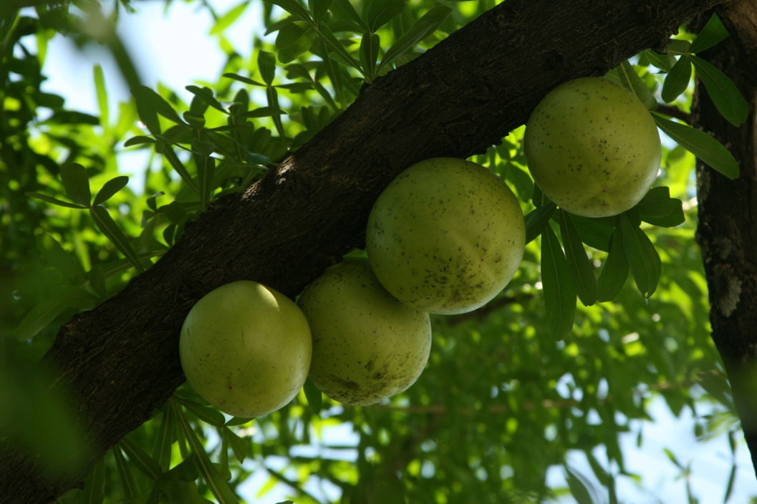
A sacred plant, Morro Tree (Crescentia alata)
This species is cauliflorous, meaning that the fruit and the flowers grow directly attached to the trunk and branches.
Another tree that is cauliflorous is cacao trees ( Theobroma cacao).
Folder: Ethnobotany; Morro_Crescentia_alata_Jenya 095
www.Maya-ethnobotany.org
4
© FLAAR Mesoamerica 2011

Slide 6
A sacred plant, Morro Tree (Crescentia alata)
Morro flowers have an odor of musk, that is strongest during the night. This odor attracts bats.
Folder: Ethnobotany; morro_immature_barely_open_flower_669
Flower buds
www.Maya-ethnobotany.org
5
© FLAAR Mesoamerica 2011

Slide 7
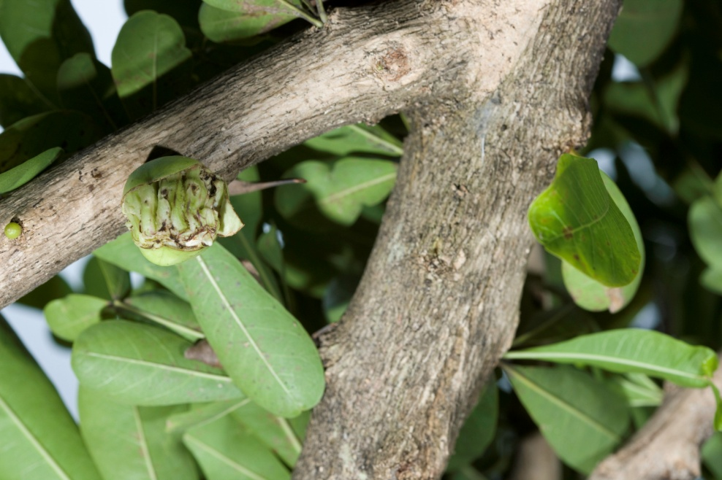
A sacred plant, Morro Tree (Crescentia alata)
These are immature flowers. Here the bud is beginning to open, and you can see the flower coming out
Folder: Ethnobotany; morro_flower_bud_barely_cracked_open691
At the beginning not all the flowers present purple color, but as they grow they become purple
Folder: Ethnobotany; morro_immature_flower_648
www.Maya-ethnobotany.org
6
© FLAAR Mesoamerica 2011

Slide 8
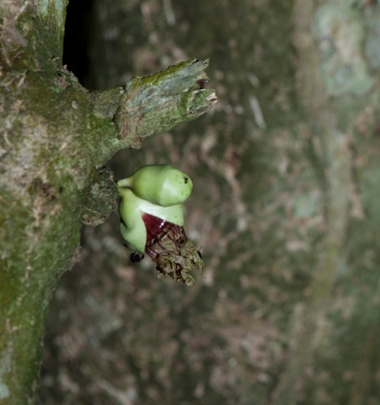
A sacred plant, Morro Tree (Crescentia alata)
These is a sequence of the bud opening and becoming the flower
Folder: Ethnobotany; Morro_Autosafari_August_2011:_ _MG_5868
Folder: Ethnobotany; morro_bud_cracking_open_barely_640
Folder:Ethnobotany; morro_immature_opening_flower_666
Folder: Ethnobotany; Morro_Autosafari_August_2011:_MG_5853
www.Maya-ethnobotany.org
7
© FLAAR Mesoamerica 2011

Slide 9
A sacred plant, Morro Tree (Crescentia alata)
Here the flower has grown more, and is starting to open.
Folder: Ethnobotany; morro_flowers_two_stages_opening_708
www.Maya-ethnobotany.org
8
© FLAAR Mesoamerica 2011

Slide 10
A sacred plant, Morro Tree (C. alata)
These flowers are completely open.
Folder: Ethnobotany; morro_flowers_three_stages_opening_711
www.Maya-ethnobotany.org
9
© FLAAR Mesoamerica 2011

Slide 11
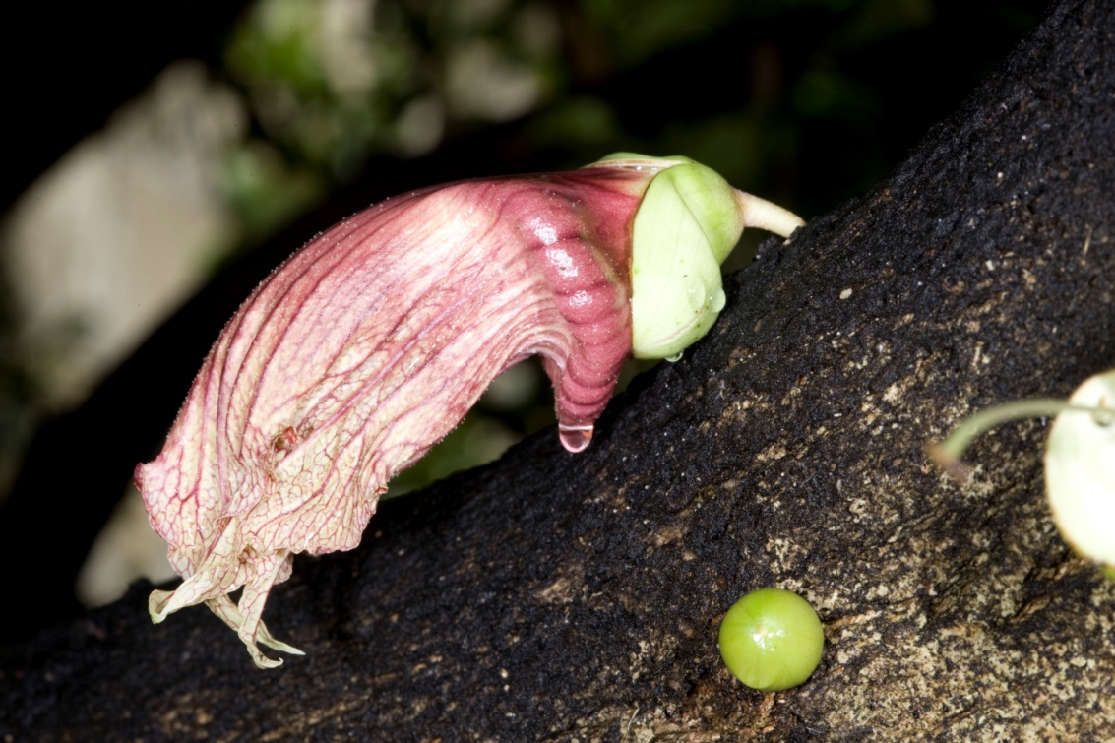
A sacred plant, Morro Tree (C. alata)
C. alata flowers are pollinated by bats, so they are more open during the night. But they also begin to pop out of their bud enclosures during the afternoon.
Folder: Ethnobotany; morro_immature_open_flower_632
Folder: Ethnobotany; morro_flower_profile_994
www.Maya-ethnobotany.org
10
© FLAAR Mesoamerica 2011

Slide 12
A sacred plant, Morro Tree (C. alata)
Since the flowers tend to always look closed, it is hard to judge what stage they are. And we have not done much study of the trees in the middle of the night.
It is also not easy to tell which flowers are “closed”(meaning immature before opening) and when they are finished blooming.
Folder: Ethnobotany; morro_flowers_three_stages_opening_711
www.Maya-ethnobotany.org
11
© FLAAR Mesoamerica 2011

Slide 13
A sacred plant, Morro Tree (C.alata)
These pictures were taken in Monterrico, at the end of the afternoon. Here you can see fresh flowers really open. We need to also study the trees at night to see if the flowers open even further.
Folder: Ethnobotany; morro_flower_Monterrico_961
12
Folder: Ethnobotany; morro_flower_Monterrico_frontal_964
www.Maya-ethnobotany.org
© FLAAR Mesoamerica 2011

Slide 14
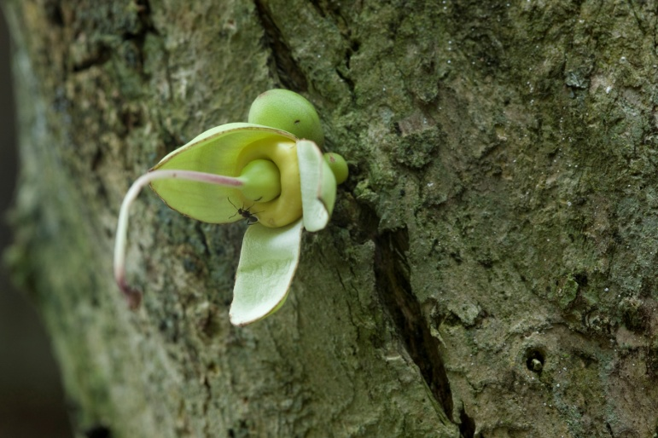
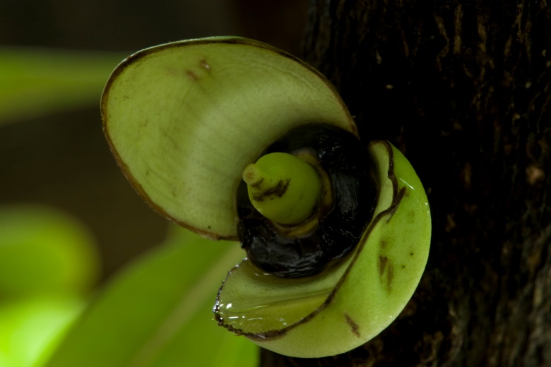
A sacred plant, Morro Tree (C. alata)
Folder: Ethnobotany; Morro_Autosafari_August_2011: _MG_5840
Folder: Ethnobotany; morro_flower_Monterrico_fruit-bud_980
After the flower falls off the tree, the fruit starts to grow.
Folder: Ethnobotany; morro_flower_Monterrico_fruit-bud_990
www.Maya-ethnobotany.org
13
© FLAAR Mesoamerica 2011

Slide 15
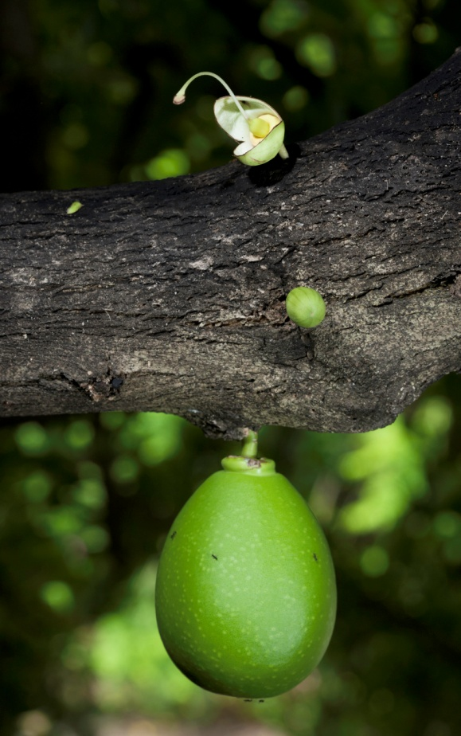
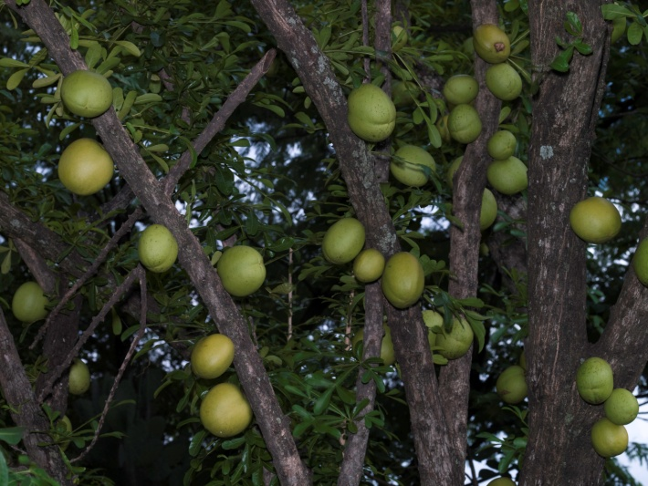
A sacred plant, Morro Tree
The fruit, same as the flower, grows directly from the trunk.
The fruit spends up to seven months in the tree, maturing until it falls off the tre.
Folder: Ethnobotany; CF008551
Folder: Ethnobotany; morro_small_oval_fruit_above_string_bud_659
Folder: Ethnobotany; morro_Crescentia_alata_many_650
www.Maya-ethnobotany.org
14
© FLAAR Mesoamerica 2011

Slide 16
A sacred plant, Morro Tree (Crescentia alata)
The leaves of Crescentia alata are trifoliate, or in juvenile stages the leaves can be simple or bifoliate.
The leaves allow you to distinguish C. alata from C. cujete
Trifoliate leaves
Folder:Ethnobotany; Morro_Crescentia_alata_Jenya 048
www.Maya-ethnobotany.org
15
© FLAAR Mesoamerica 2011

Slide 17
A sacred plant, Morro Tree (Crescentia alata)
This plant is very common on plains and slopes that are seasonally dry. In Guatemala the natural habitat is distributed in Alta Verapaz, Baja Verapaz, Chimaltenango, Chiquimula, El Progreso, Jalapa, Jutiapa, Santa Rosa, Zacapa and Izabal (cultivated).
But in fact you find these trees also in Peten, in house gardens. But their natural habitat is in areas that are much drier.
Folder: Ethnobotany; Morro_tree_9944
www.Maya-ethnobotany.org
16
© FLAAR Mesoamerica 2011

Slide 18
www.Maya Ethnobotany.org
For more information visit
www.Maya-ethnobotany.org
All photos were taken by FLAAR Mesoamerica staff. To quote the presentation and the pictures:
Photos (FLAAR 2011)
FLAAR Mesoamerica. 2011. PowerPoint Presentation about Pacaya
www.Maya-ethnobotany.org
17
© FLAAR Mesoamerica 2011

Slide 19
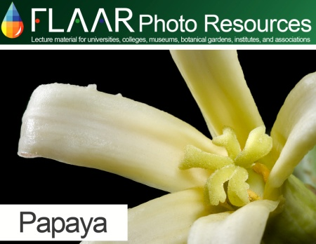
www.Maya Ethnobotany.org
Other PowerPoint presentations with photos of other Maya ethnobotany plants from the FLAAR Photo Archive include:
Achiote (Bixa orellana)
Papaya (Carica papaya)
www.Maya-ethnobotany.org
18
© FLAAR Mesoamerica 2011

