Slide 1
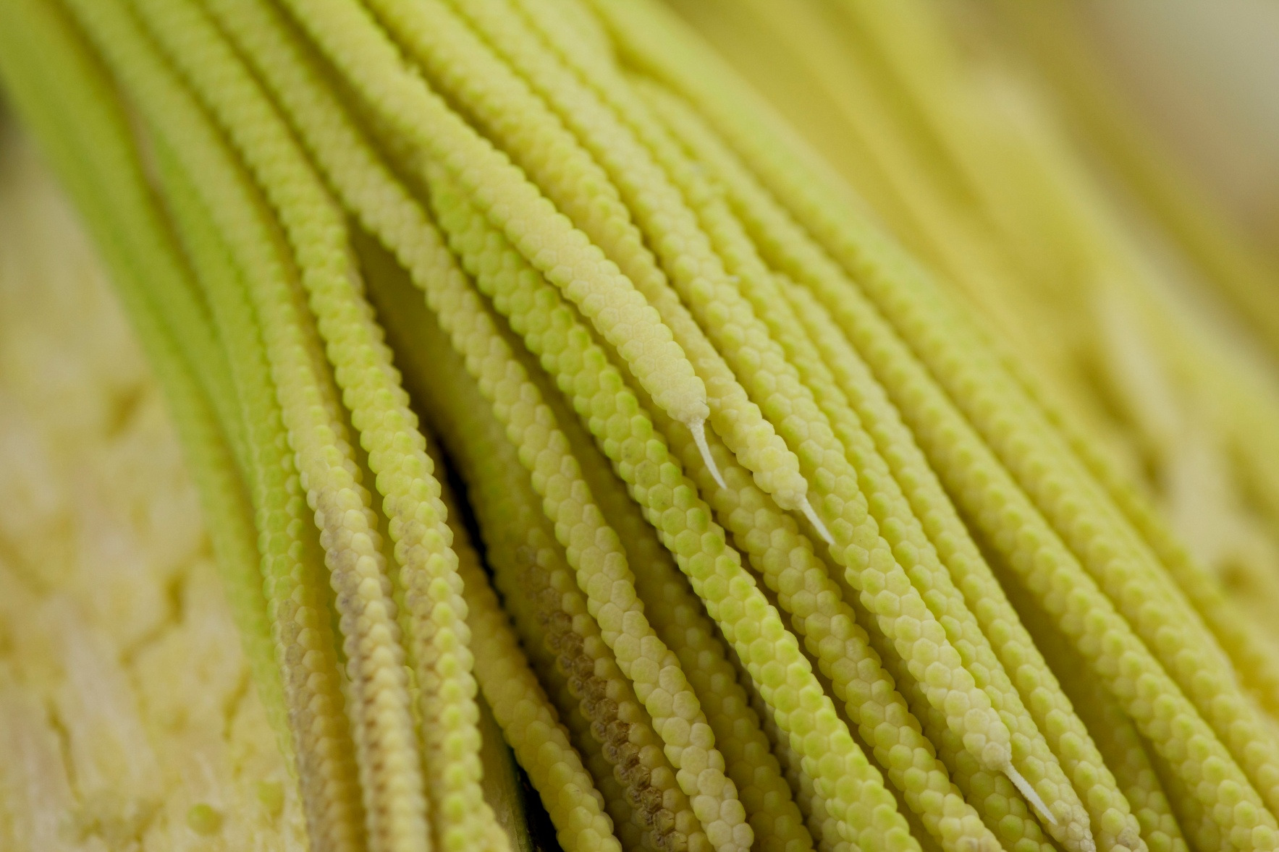
Pacaya palm, Chamaedorea tepejilote
Folder: FLAAR-Files; ETHNOBOTANY; Pacaya; Pacaya_002
Maya Ethnobotany
www.Maya-ethnobotany.org

Slide 2
No cost or obligation to use FLAAR PowerPoint presentations (if copyright notice and logo remain in place)
PowerPoint presentations are courtesy of FLAAR Reports for colleges, universities, museums, nature parks, or any comparable educational and scientific institution.
There is no cost or obligation to use these PowerPoint presentations from FLAAR Reports as long as the format, logo, and reference to www.maya-ethnobotany.org remain in place.
However these photographs are all copyright and are not intended for inappropriate use. Inappropriate use is dumping them on your own web site and pretending they are your photos. The ethical way to do this is to leave them on the FLAAR web site(s) and link to them
If there are other pre-Columbian Mesoamerican flowers,plants or trees that you really wish to have a PPT on from FLAAR, please let us know. Also, if you wish Dr Hellmuth to give this lecture himself, at your university, museum, club, or group, anywhere in the world, he lectures around the world every year, especially relative to Maya iconography of plants and animals, and on digital photography of flora and fauna.
If you find this innovative concept of a non-profit research institute providing no-cost PowerPoint presentations to curators, faculty, and students as a good idea, please let us know.
If you find any error or omission in this presentation, or if you know anything that we missed, please let us know to consider it. Write to FrontDesk@FLAAR.org
We have deliberately left the PPT with no text so the speaker who borrows this can add their own words.
www.Maya-ethnobotany.org
1
© FLAAR Mesoamerica 2011

Slide 3
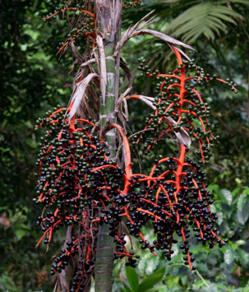
Pacaya, an edible flower
Family: Arecacea
Scientific name: Chamaedorea tepejilote
Common name: Pacaya
Folder: FLAAR-Files; ETHNOBOTANY; Pacaya-plant-male_024
Folder: FLAAR-Files; ETHNOBOTANY; Pacaya-plant-male_024
www.Maya-ethnobotany.org
2
© FLAAR Mesoamerica 2011

Slide 4
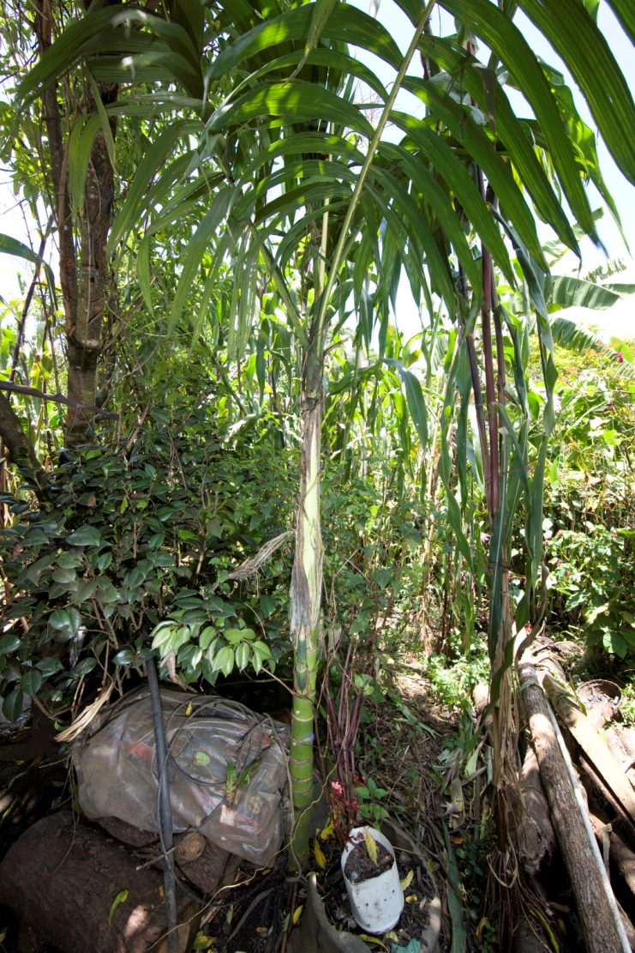
Pacaya, an edible flower
The flowers are produced in inflorescences; they are dioecious, with male and female flowers on separate plants.
Folder: FLAAR-Files; ETHNOBOTANY; Chilasco_pacaya_6033
3
Folder: FLAAR-Files; ETHNOBOTANY; pacaya_trunk_Coban_6060
www.Maya-ethnobotany.org
© FLAAR Mesoamerica 2011

Slide 5
Pacaya, an edible flower
We don’t yet have pictures of the female inflorescences. However here are some differences to distinguish them.
Female | Male
Tend to be solitary, with 5-20 thick branches. | Densely packed . They are more numerous than the female inflorescences. They have from 7-50 hanging small branches.
www.Maya-ethnobotany.org
4
© FLAAR Mesoamerica 2011

Slide 6
Pacaya, an edible flower
Chamaedorea tepejilote, male plant with mature fruits
These berries are not what you eat of the plant.
Folder: FLAAR-Files; ETHNOBOTANY; Pacaya-plant-male_029
www.Maya-ethnobotany.org
5
© FLAAR Mesoamerica 2011

Slide 7
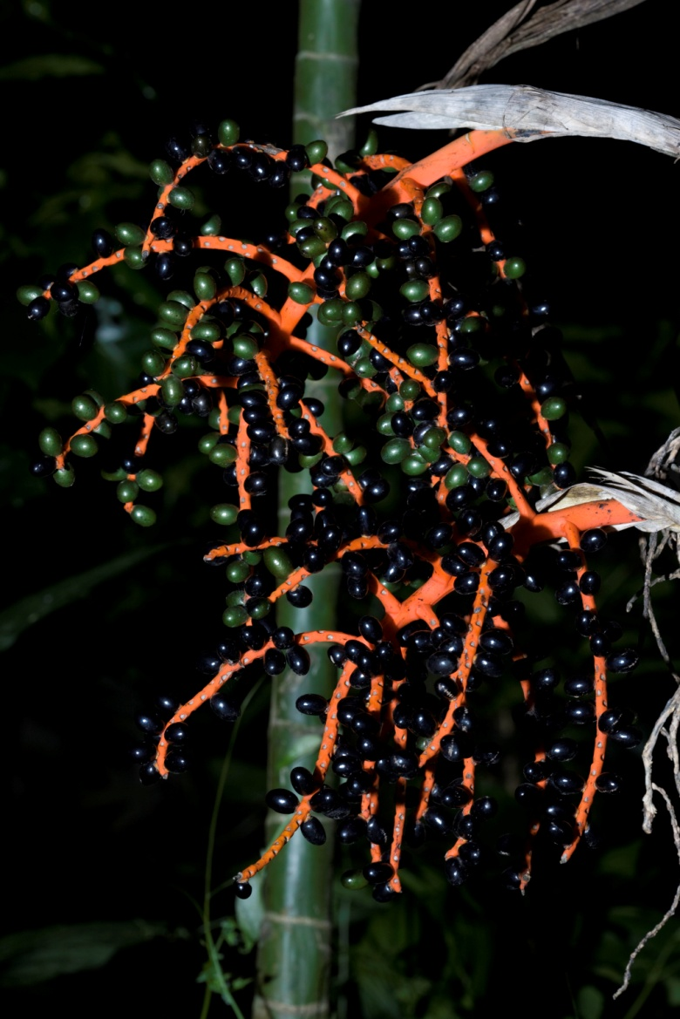
Pacaya, an edible flower
Folder: FLAAR-Files; ETHNOBOTANY; Pacaya-plant-male_051
Chamaedorea tepejilote Male plant with fruits
Folder: FLAAR-Files; ETHNOBOTANY; Pacaya-plant-male_046
www.Maya-ethnobotany.org
6
© FLAAR Mesoamerica 2011

Slide 8
Pacaya, an edible flower
Folder: FLAAR-Files; ETHNOBOTANY; Pacaya-plant-male_055
7
Folder: FLAAR-Files; ETHNOBOTANY; Pacaya-plant-male_056
www.Maya-ethnobotany.org
© FLAAR Mesoamerica 2011

Slide 9
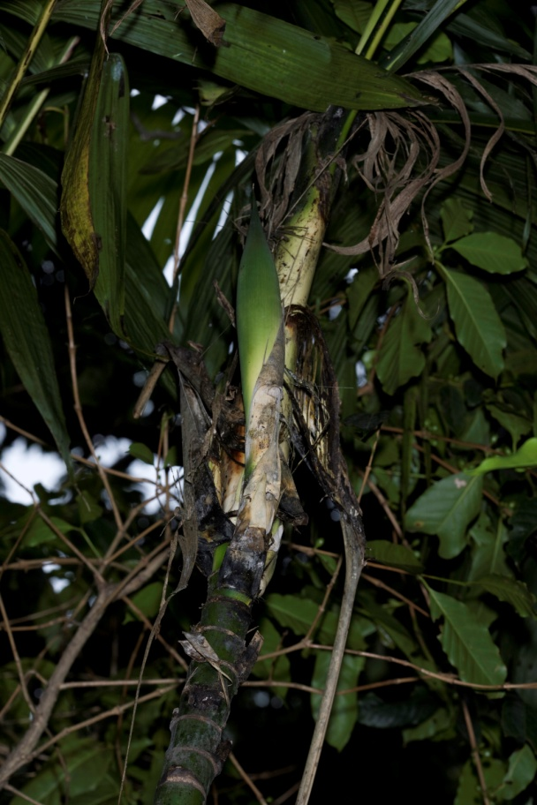
Pacaya, an edible flower
Chamaedorea tepejilote Female plants with fruits. The fruits of these plant are edible
This is the inflorescense that you can eat.
Because you eat it is very common to find it in cultivated in houses
Folder: FLAAR-Files; ETHNOBOTANY; Pacaya-plant-female_011
Inflorescence
Folder: FLAAR-Files; ETHNOBOTANY; Pacaya-plant-female_012
www.Maya-ethnobotany.org
8
© FLAAR Mesoamerica 2011

Slide 10
Pacaya, an edible flower
Male inflorescence
9
Folder: FLAAR-Files; ETHNOBOTANY; pacaya_pod_&_opened_8001
www.Maya-ethnobotany.org
© FLAAR Mesoamerica 2011

Slide 11
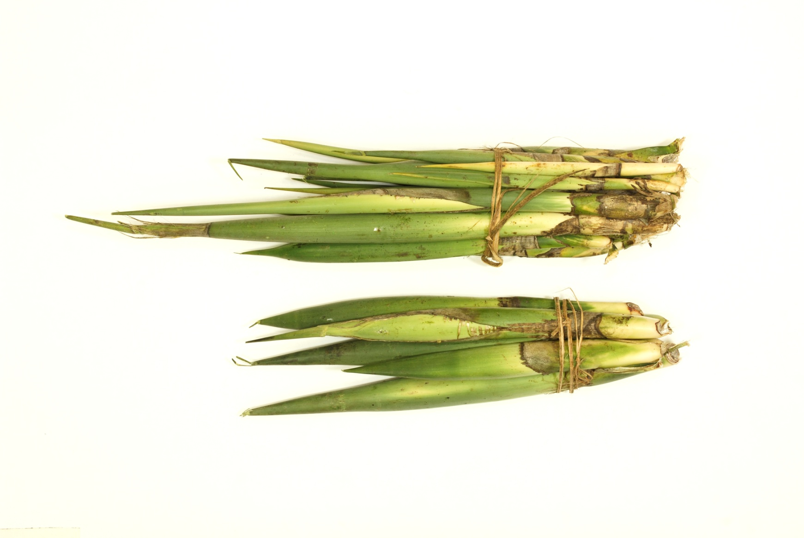
Pacaya, an edible flower
Pacaya palm, Chamaedorea tepejilote
This is how the local farmers package the pacaya to sell it in local markets
Male inflorescence
Folder: Database2; ETHNOBOTANY; Pacaya_bundles_AB15
www.Maya-ethnobotany.org
10
© FLAAR Mesoamerica 2011

Slide 12
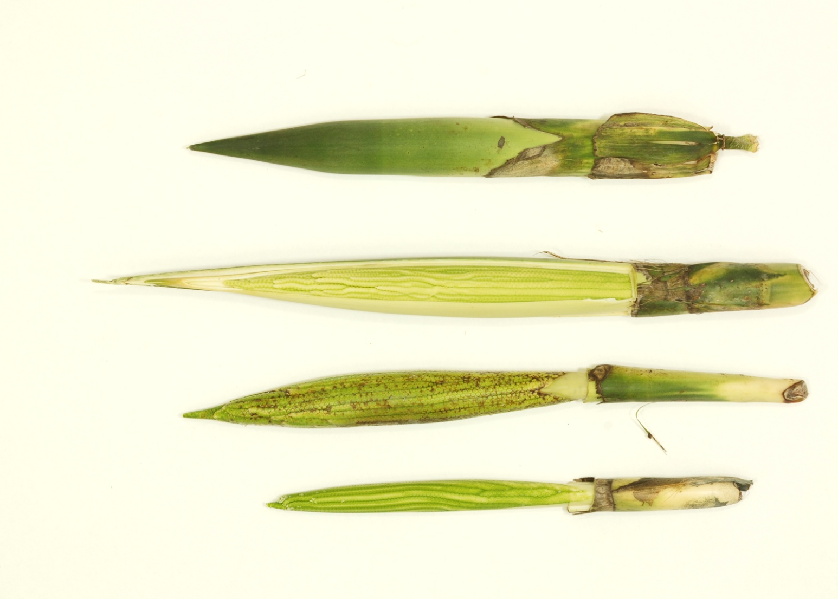
Pacaya an edible plant
Pacaya palm, Chamaedorea tepejilote
Male inflorescence
Unopened pacaya
Top half of the husk removed
Completely cut open
Folder: Database2; ETHNOBOTANY; Pacaya_Verapaz_AB23
www.Maya-ethnobotany.org
11
© FLAAR Mesoamerica 2011

Slide 13
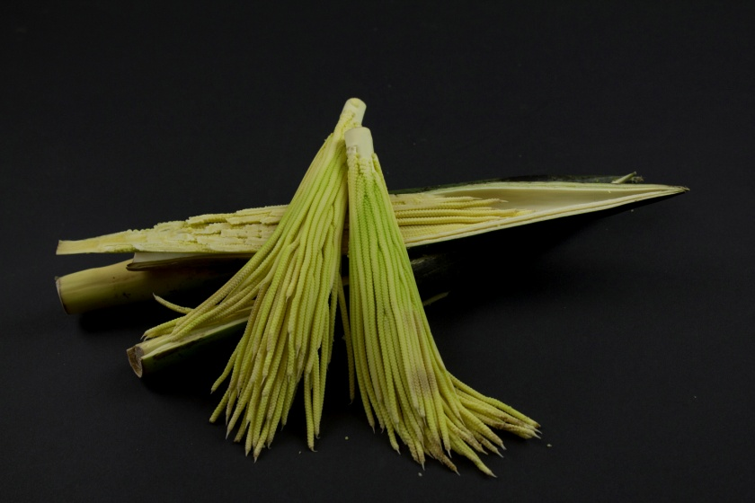
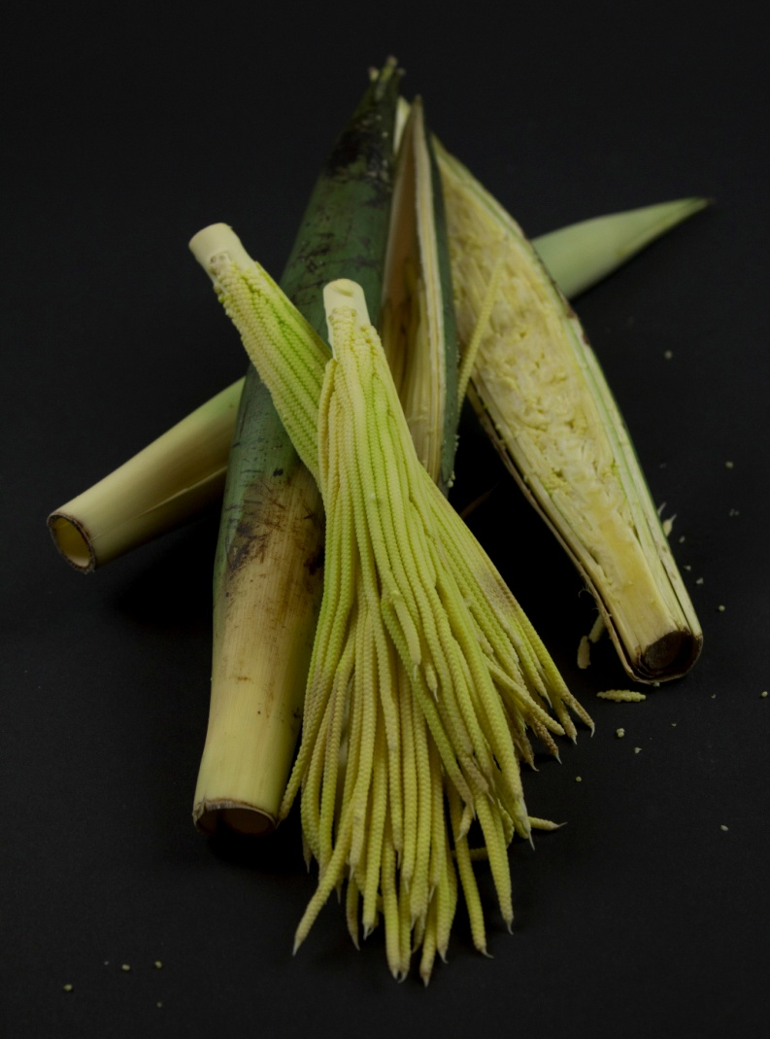
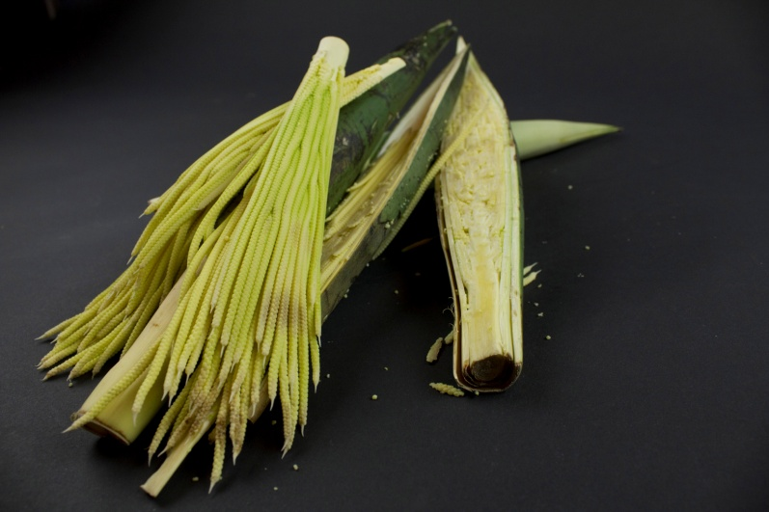
Pacaya, an edible flower
Male inflorescence
Edible parts
Folder: FLAAR-Files; ETHNOBOTANY; Pacaya_007
Folder: FLAAR-Files; ETHNOBOTANY; Pacaya_008
Folder: FLAAR-Files; ETHNOBOTANY; Pacaya_016
www.Maya-ethnobotany.org
12
© FLAAR Mesoamerica 2011

Slide 14
www.Maya Ethnobotany.org
For more information visit
www.Maya-ethnobotany.org
All photos were taken by FLAAR Mesoamerica staff.
To quote the presentation and the pictures:
Photos (FLAAR 2011)
FLAAR Mesoamerica. 2011. PowerPoint Presentation about Pacaya, www.maya-ethnobotany.org
www.Maya-ethnobotany.org
13
© FLAAR Mesoamerica 2011

Slide 15
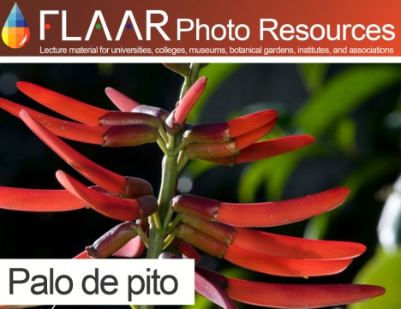
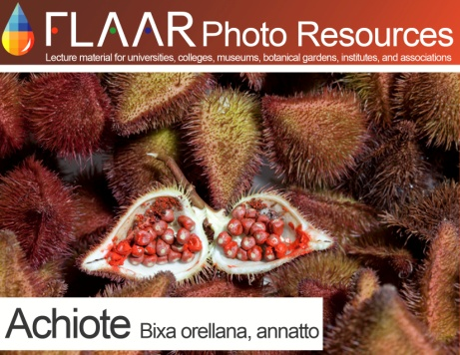
www.Maya Ethnobotany.org
Other PowerPoint presentations with photos of other Maya ethnobotany plants from the FLAAR Photo Archive include:
Palo de pito (Erythrina berteroana)
Achiote (Bixa orellana)
www.Maya-ethnobotany.org
14
© FLAAR Mesoamerica 2011

