Slide 1
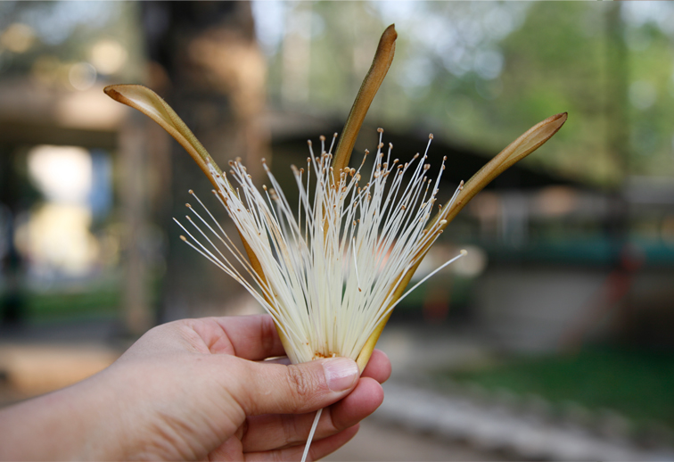
Ceiba Tree
Ceiba aesculifolia
Maya Ethnobotany

Slide 2
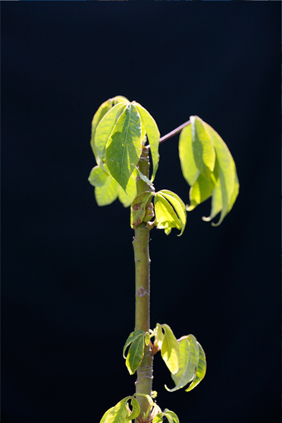
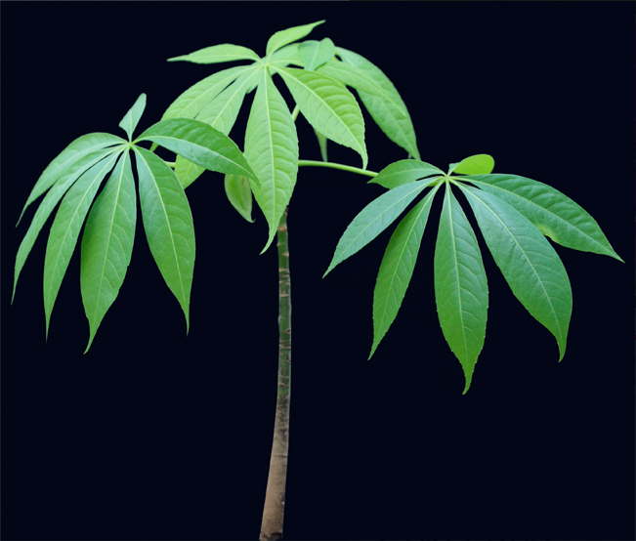
Maya Ethnobotany
Baby Ceiba

Slide 3
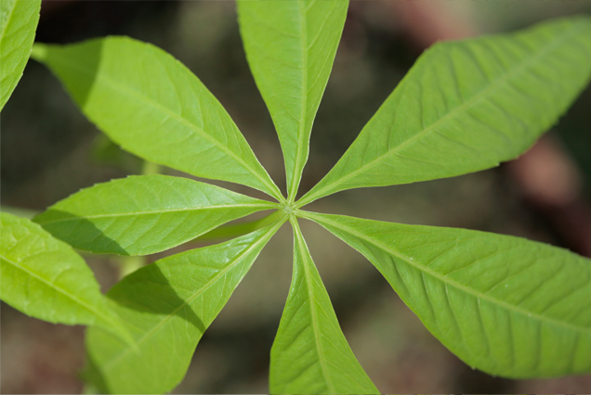
Maya Ethnobotany
Ceiba Bombacaceae

Slide 4
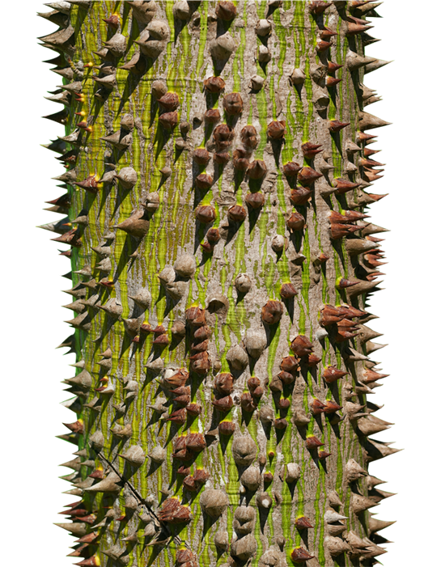
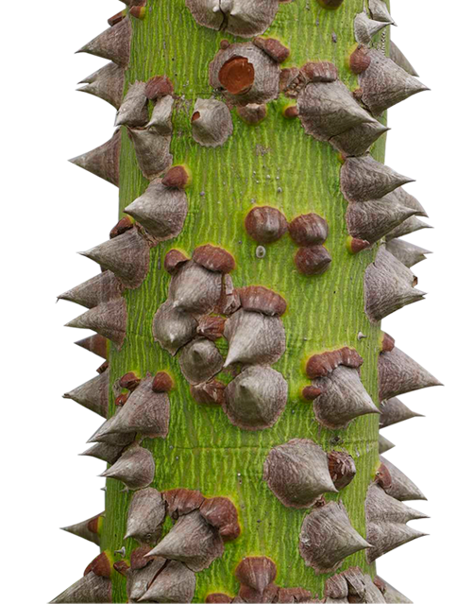
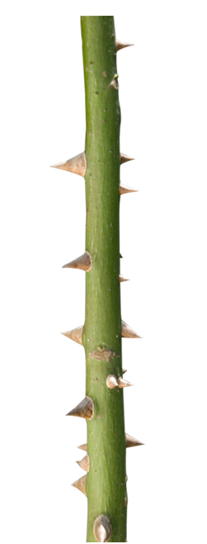
Maya Ethnobotany
Growing Ceiba trunk

Slide 5
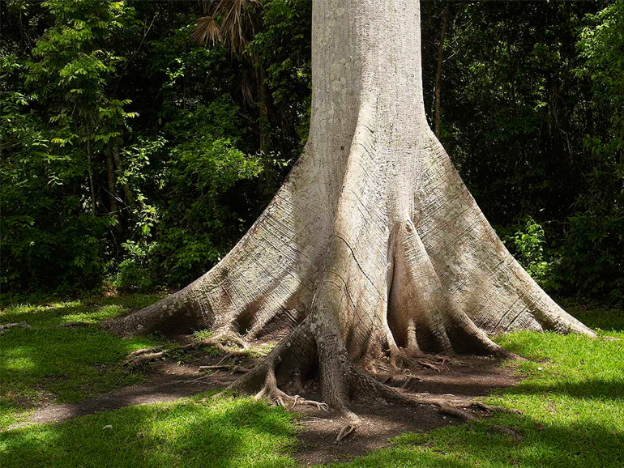
Maya Ethnobotany
Ceiba trunk

Slide 6
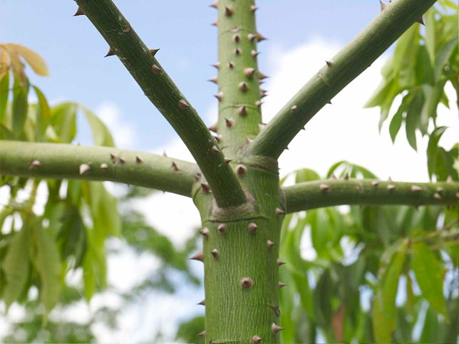
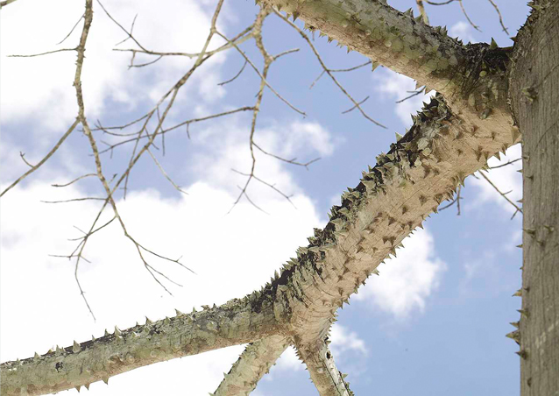
Maya Ethnobotany
Ceiba branches

Slide 7
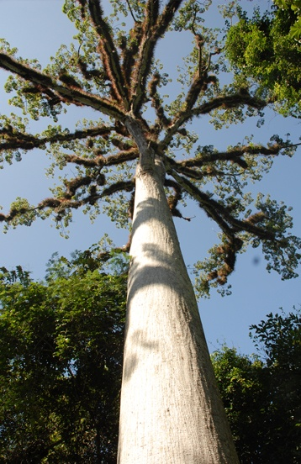
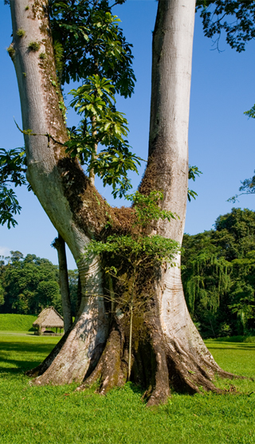
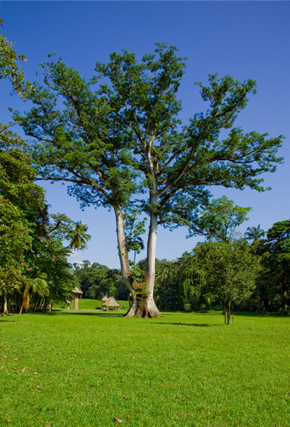
Maya Ethnobotany
Ceiba tree

Slide 8
Maya Ethnobotany
Nicholas Hellmuth planting a Ceiba tree in FLAAR headquarters

Slide 9
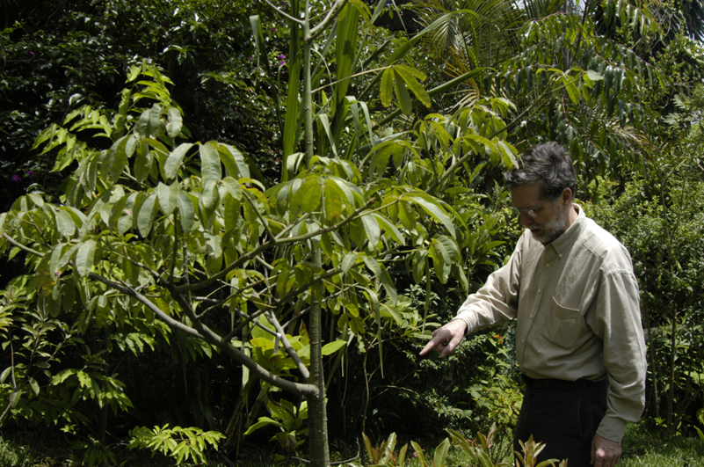
Nicholas Hellmuth next to ceiba tree in FLAAR headquarters

